Slide 1


Spatial Data Analytics for Subsurface Modelling
Inha University
Energy Resources Engineering
조 홍 근
2023.5.12

Slide 2
Agenda
Random variable vs. Random function
Stationarity vs. Trend
Spatial continuity: Variogram
Spatial estimation: Kriging & Simulation
GSLIB demo using Python
2D and 3D Modelling with SGS/SIS/MPS

Slide 3
Agenda
Random variable vs. Random function
Stationarity vs. Trend
Spatial continuity: Variogram
Spatial estimation: Kriging & Simulation
GSLIB demo using Python
2D and 3D Modelling with SGS/SIS/MPS

Slide 4
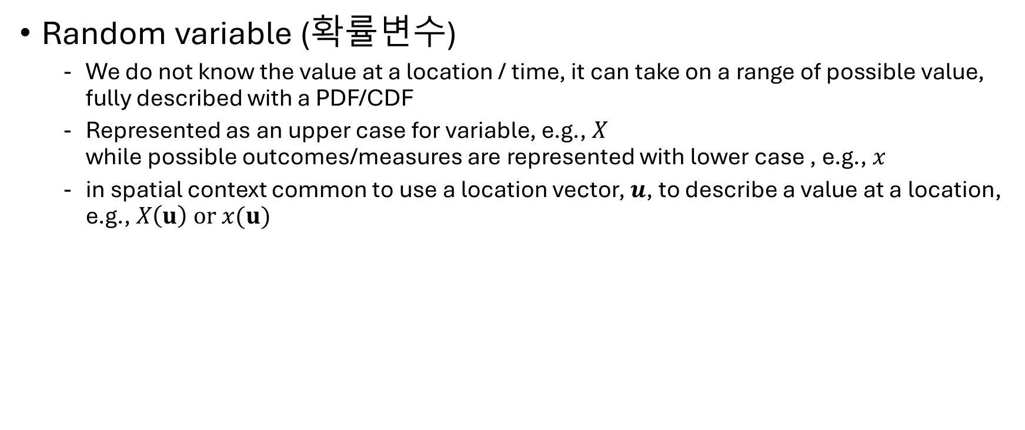
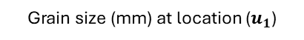
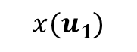
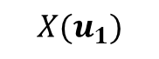
Definition: random variable (RV)
Random variable (확률변수)
We do not know the value at a location / time, it can take on a range of possible value, fully described with a PDF/CDF
Represented as an upper case for variable, e.g., $X$ while possible outcomes/measures are represented with lower case , e.g., $x$
in spatial context common to use a location vector, $u$, to describe a value at a location, e.g., $X\left(u\right) or x(u)$
$$X(u_{1})$$
50
$$x(u_{1})$$
25
Probability (%)
0
0
10
20
Grain size (mm) at location ($u_{1}$)

Slide 5
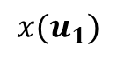
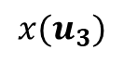
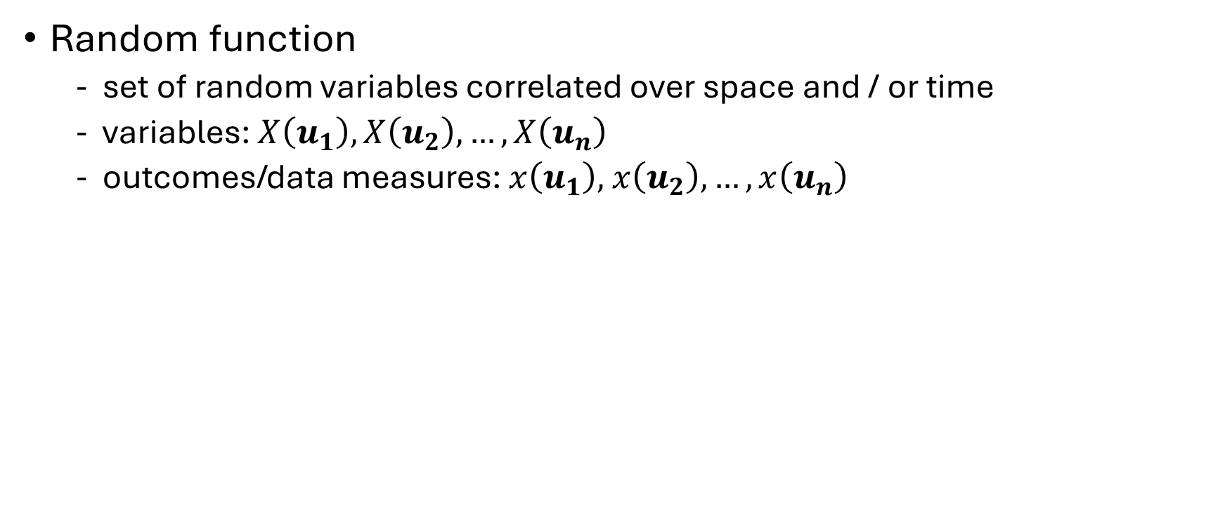
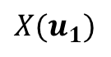
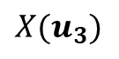
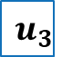
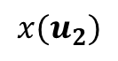
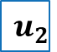
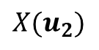



Definition: random function (RF)
Random function
set of random variables correlated over space and / or time
variables: $X\left(u_{1}\right),X\left(u_{2}\right),…,X\left(u_{n}\right)$
outcomes/data measures: $x\left(u_{1}\right),$ $x\left(u_{2}\right), …,x\left(u_{n}\right)$
$$X(u_{1})$$
50
$$X(u_{2})$$
50
Y
$$u_{2}$$
$$x(u_{1})$$
$$x(u_{2})$$
25
25
Probability (%)
Probability (%)
0
0
0
10
20
0
10
20
Grain size (mm) at location ($u_{1}$)
Grain size (mm) at location ($u_{1}$)
$$u_{1}$$
50
$$X(u_{3})$$
$$u_{3}$$
$$x(u_{3})$$
25
Probability (%)
0
0
10
20
X
Grain size (mm) at location ($u_{1}$)

Slide 6
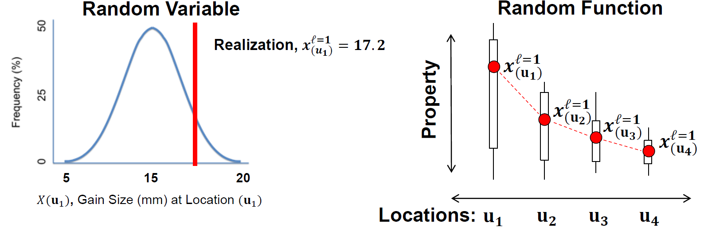
Definition: Realization
Realization
an outcome from a random variable or joint set of out comes from a random function
Each realization considered “equiprobable”
E.g., monte-carlo simulation, sequential Gaussian simulation ← a method to sample jointly from RF

Slide 7
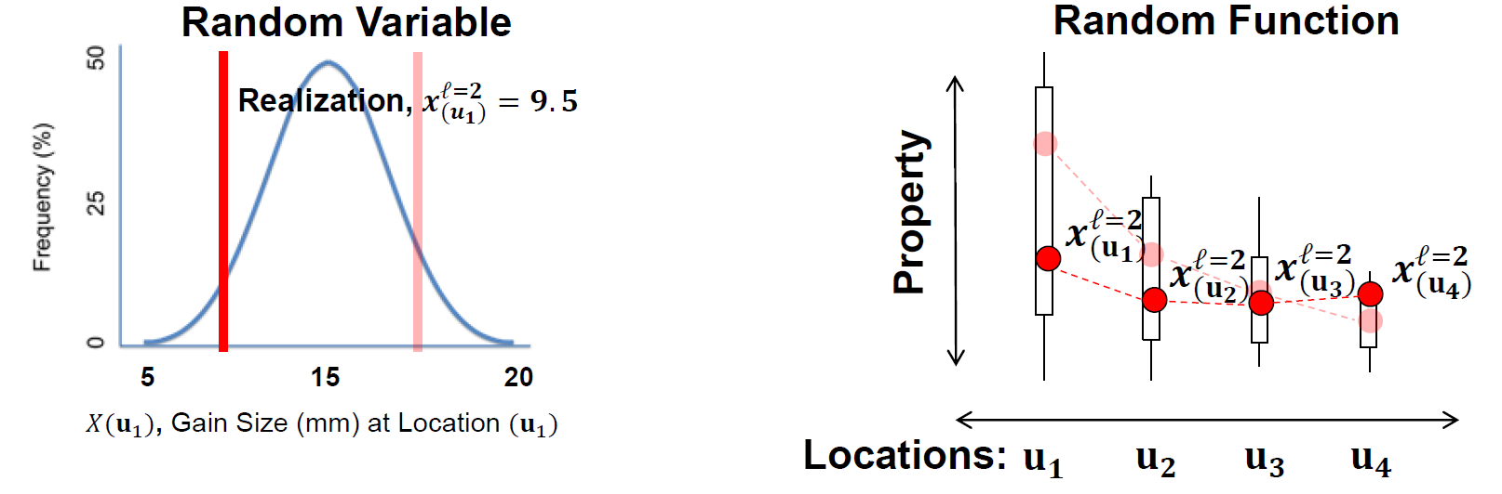
Definition: Realization
Realization
an outcome from a random variable or joint set of out comes from a random function
Each realization considered “equiprobable”
E.g., monte-carlo simulation, sequential Gaussian simulation ← a method to sample jointly from RF

Slide 8
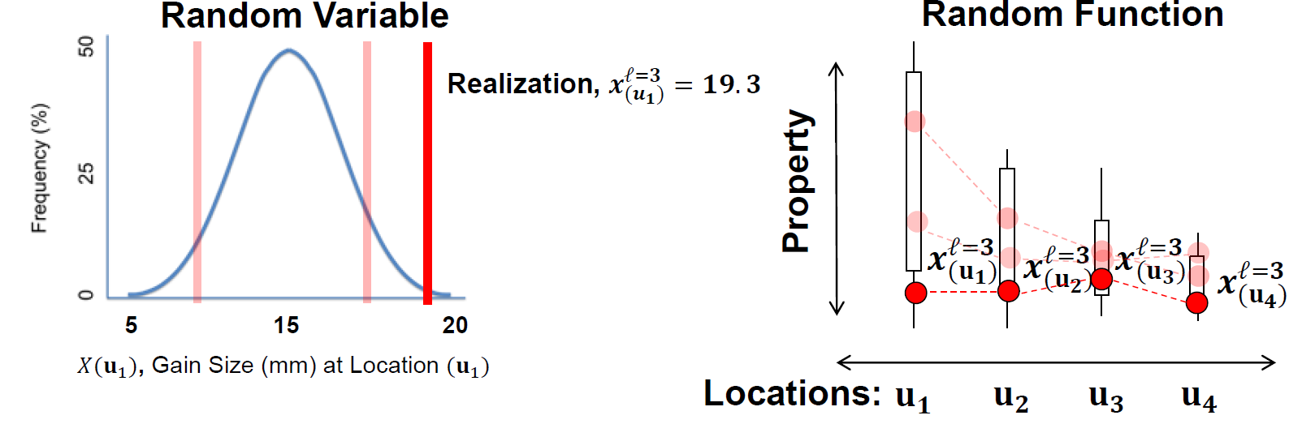
Definition: Realization
Realization
an outcome from a random variable or joint set of out comes from a random function
Each realization considered “equiprobable”
E.g., monte-carlo simulation, sequential Gaussian simulation ← a method to sample jointly from RF

Slide 9
Agenda
Random variable vs. Random function
Stationarity vs. Trend
Spatial continuity: Variogram
Spatial estimation: Kriging & Simulation
GSLIB demo using Python
2D and 3D Modelling with SGS/SIS/MPS

Slide 10

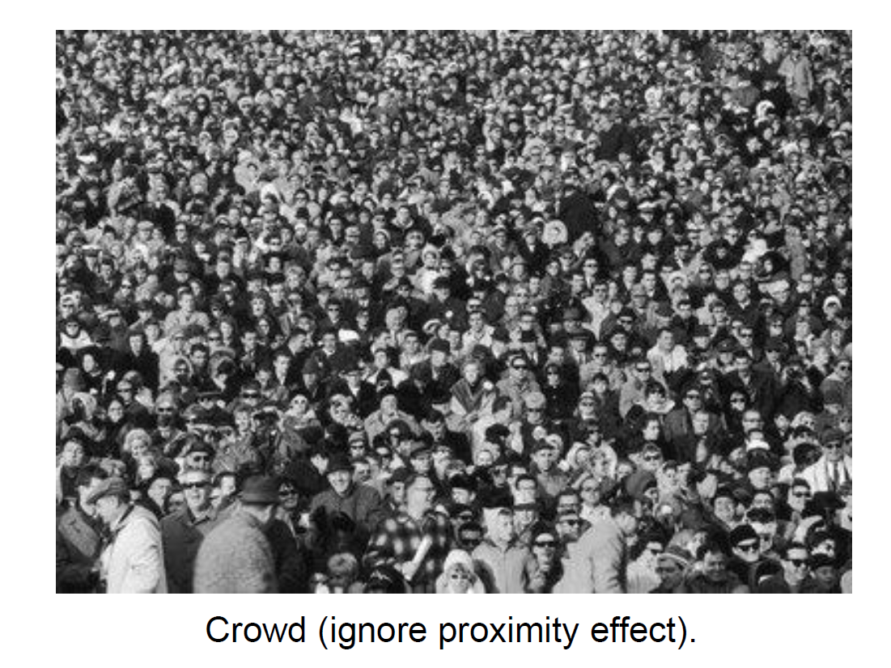
Stationarity
Q. Under which statistics/metric?

Slide 11
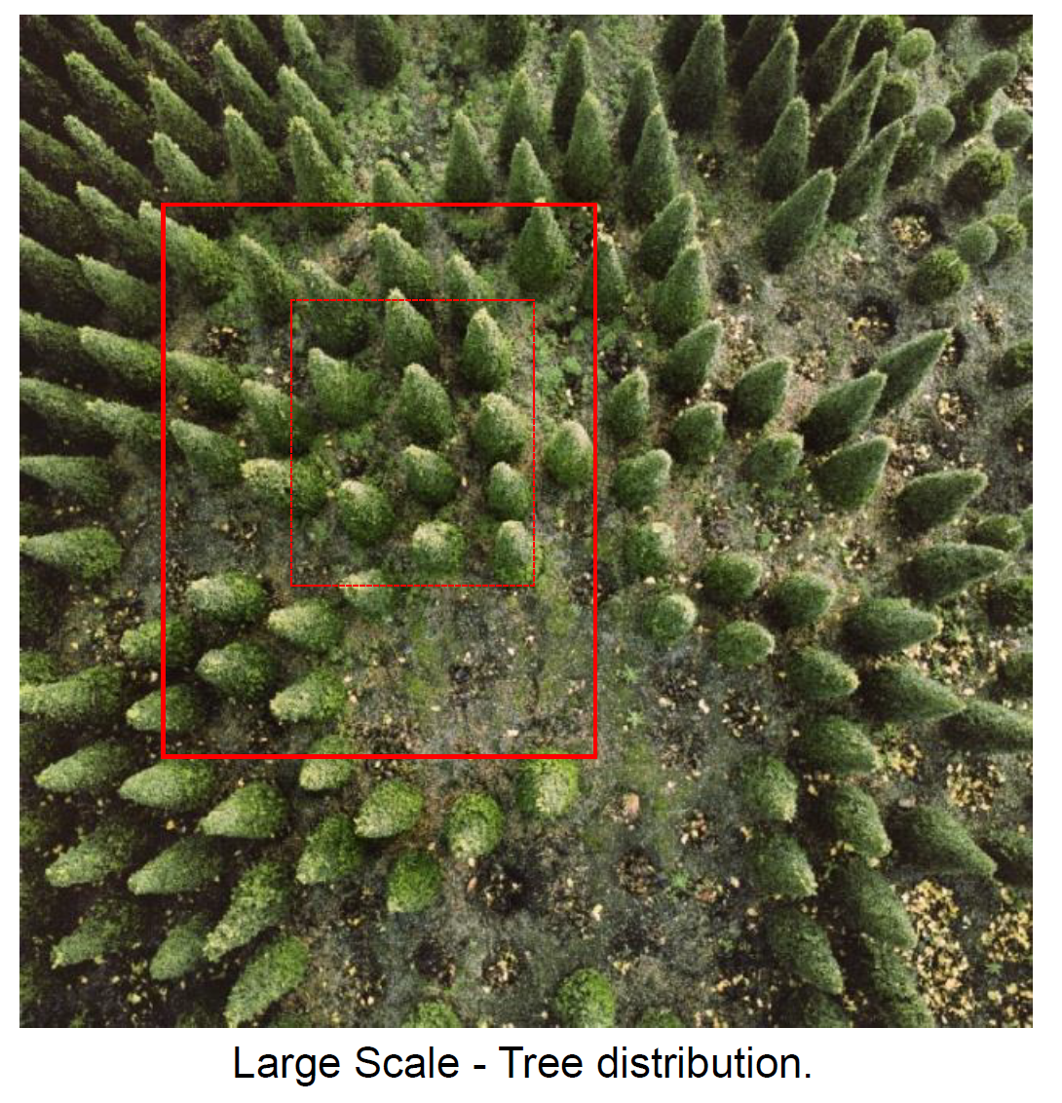
Stationarity
Q. Under which scale?

Slide 12
Stationarity Definition
Stationarity – “Statistic/metric” is invariant under translation over an interval e.g., region, time period, etc
What is stationary? Need a metric, e.g., mean, std, density
Over what interval? Need a time/volume of interest
Depends on the model purpose
Depends on the scale of observation
Decision, not an hypothesis; therefore, it cannot be tested

Slide 13
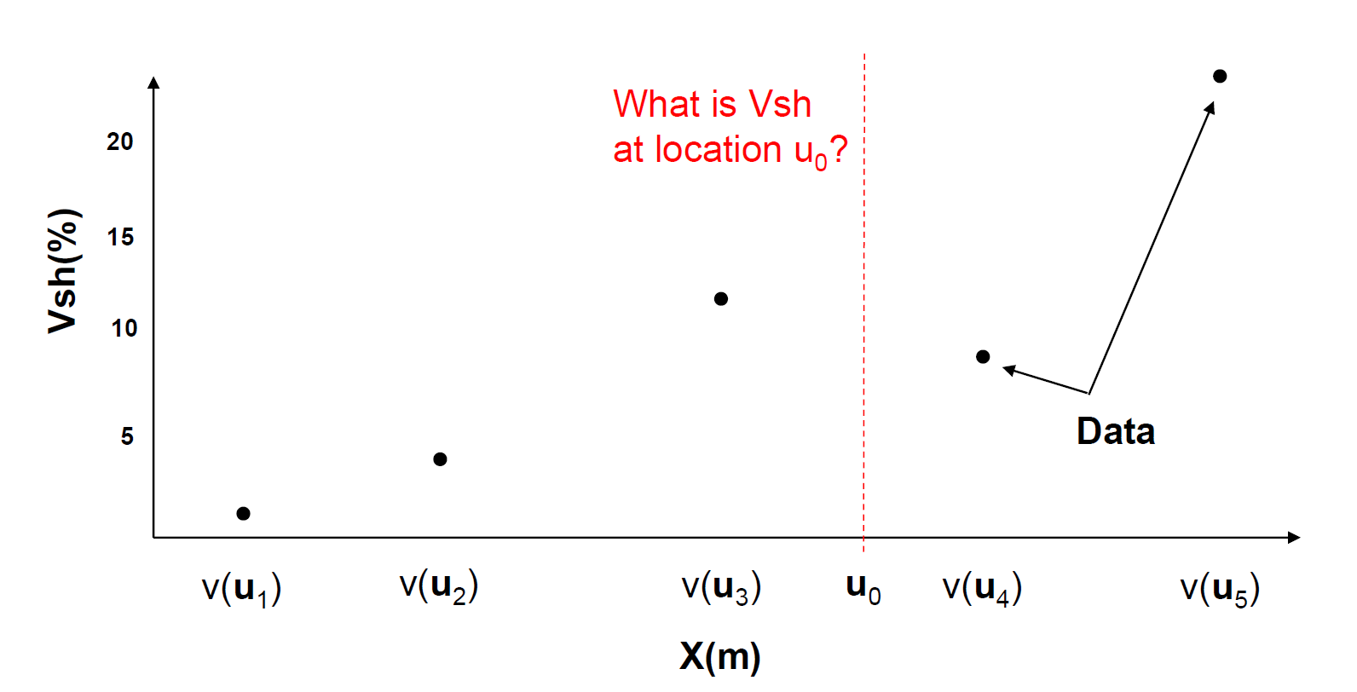
Non-stationarity
Geostatistical spatial estimation will assume stationarity
In presence of significant non-stationarity, we would not rely 100% for spatial estimation on data. “Detrend” is required

Slide 14
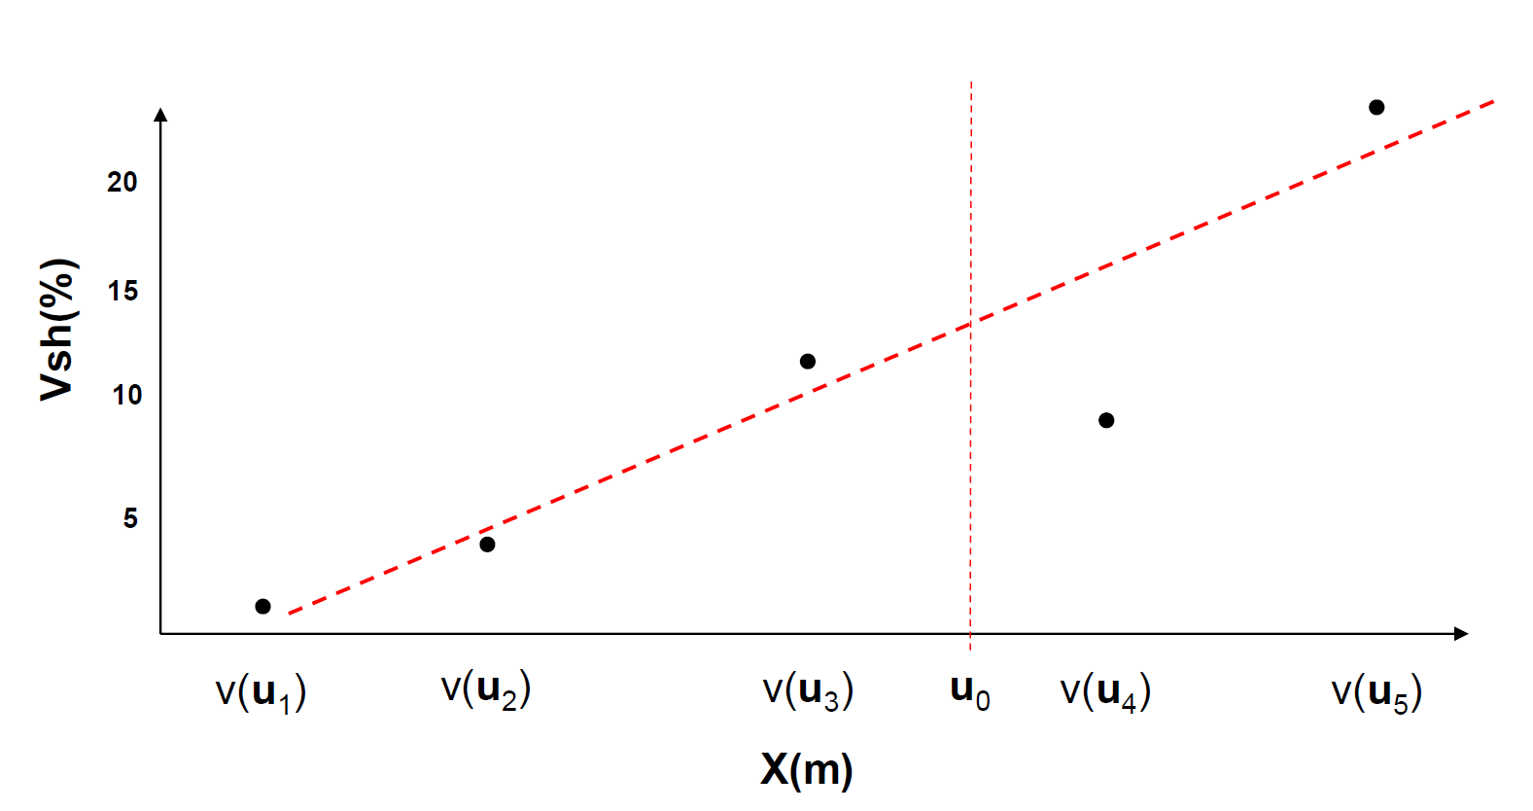
Non-stationarity
Geostatistical spatial estimation will assume stationarity
If we observe a trend or extract trend (i.e., detrending), we should model the trend as follows:

Slide 15
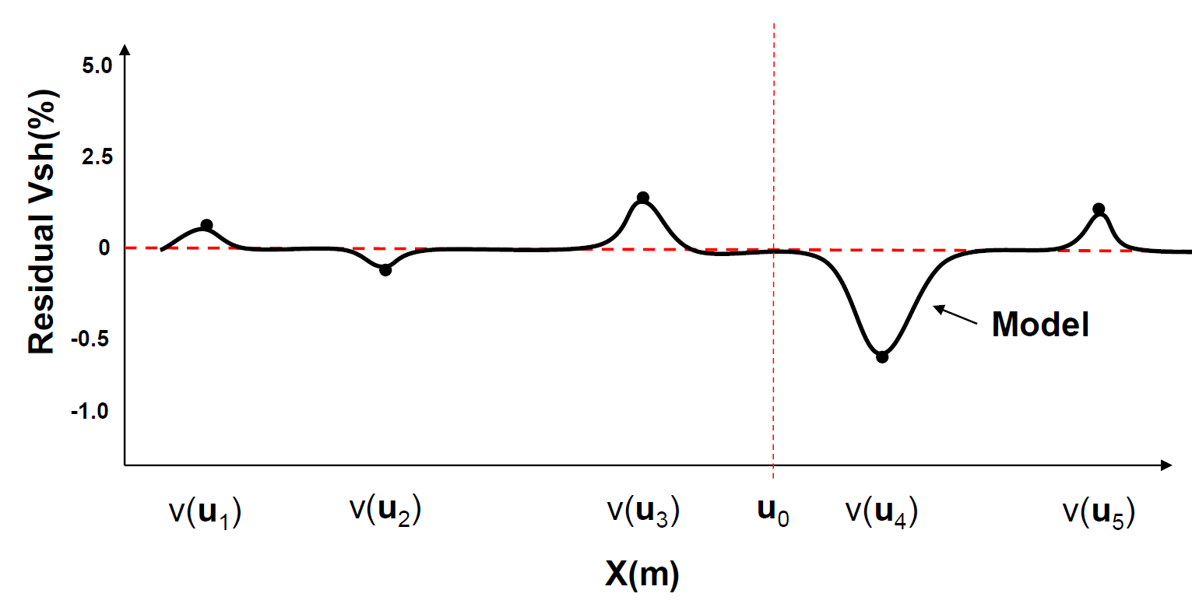
Non-stationarity
Geostatistical spatial estimation will assume stationarity
Then subtract trend to get residuals and model residuals

Slide 16
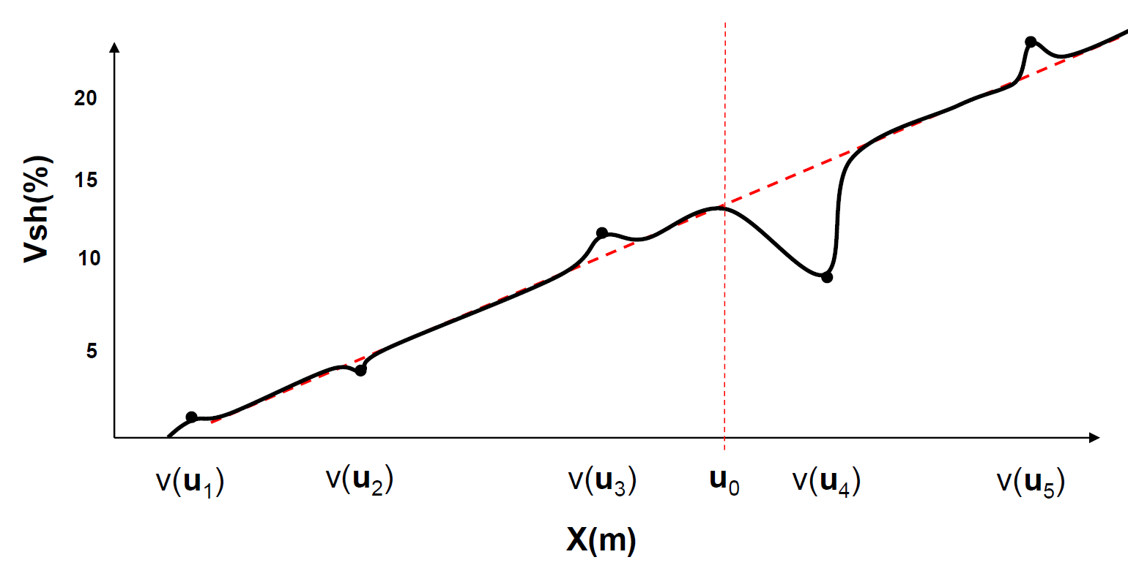
Non-stationarity
Geostatistical spatial estimation will assume stationarity
After modeling, add trend back to the modelled residuals

Slide 17
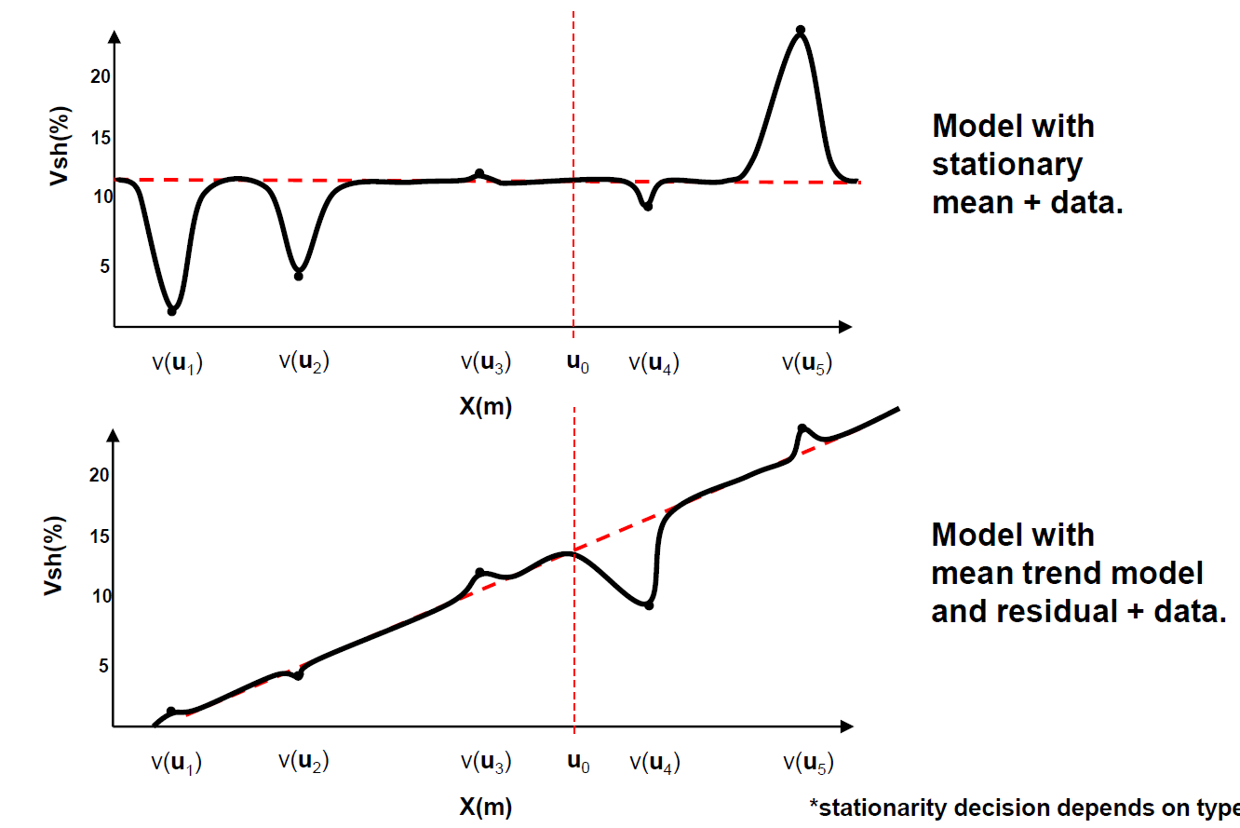
Non-stationarity
How bad could it be if we did not model a trend?
Geostatistics would assume stationarity
away from data, we would estimate with the global mean (i.e., simple kriging)

Slide 18
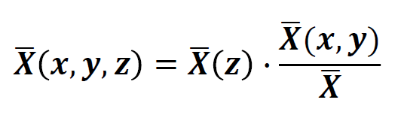
Trend modeling
Trend models:
- Tend to be smooth, based on data and interpretation
- May be complicated
- Parameterized by: (1) vertical proportion curves and, (2) areal trend map
Areal trend
Vertical trend

Slide 19
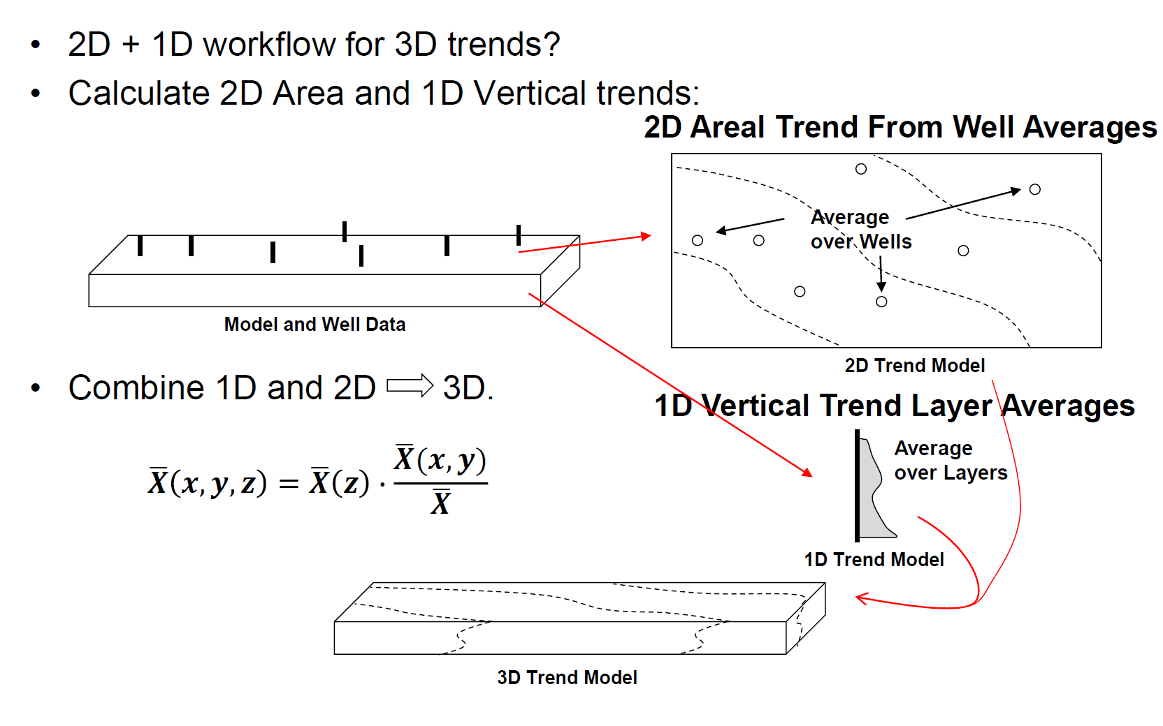
Trend modeling

Slide 20
Agenda
Random variable vs. Random function
Stationarity vs. Trend
Spatial continuity: Variogram
Spatial estimation: Kriging & Simulation
GSLIB demo using Python
2D and 3D Modelling with SGS/SIS/MPS

Slide 21
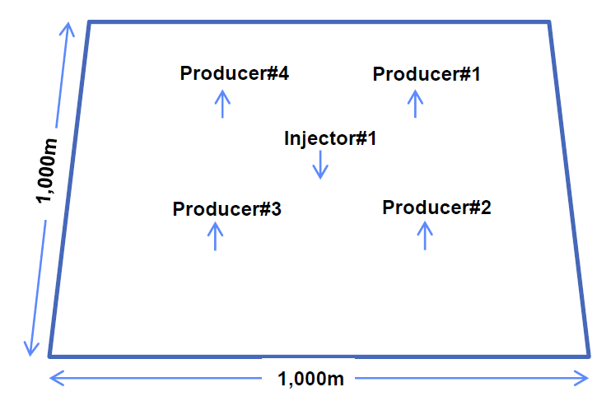
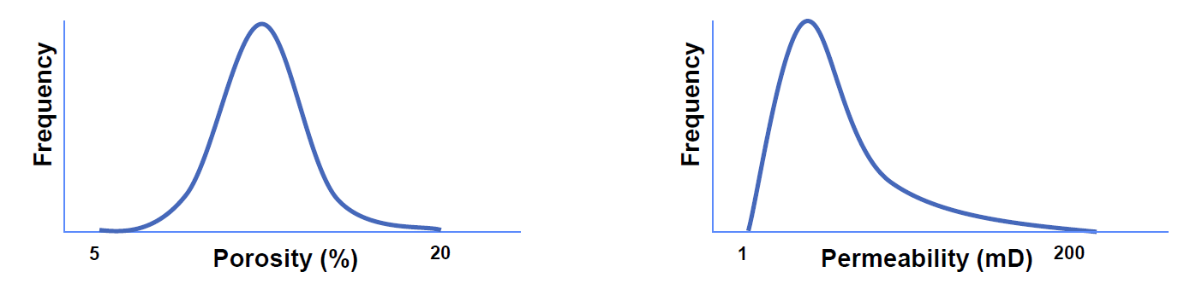
Motivation for Measuring Spatial Continuity
Let’s give a simple example:
Area of interest
1 Injector and 4 producers
Porosity and permeability distributions held constant for all cases

Slide 22
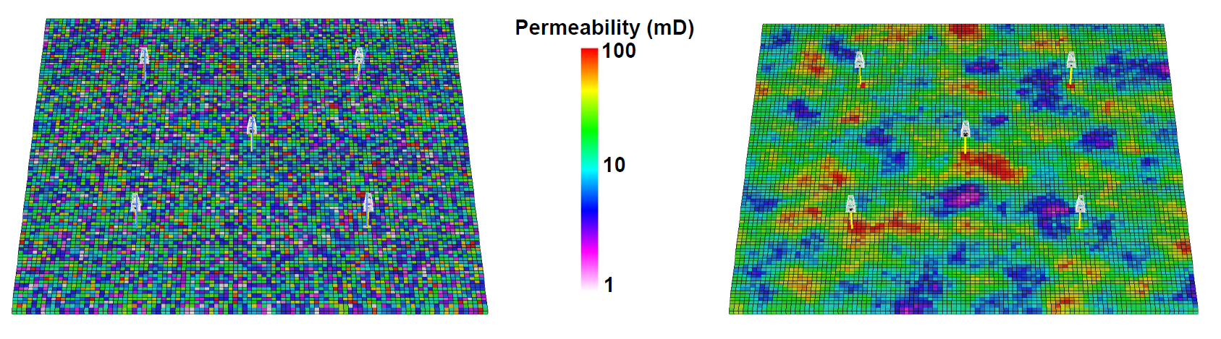
Motivation for Measuring Spatial Continuity
Does spatial continuity of reservoir properties matter?
Note that all model have the same mean/STD/P10&90 & same OOIP

Slide 23
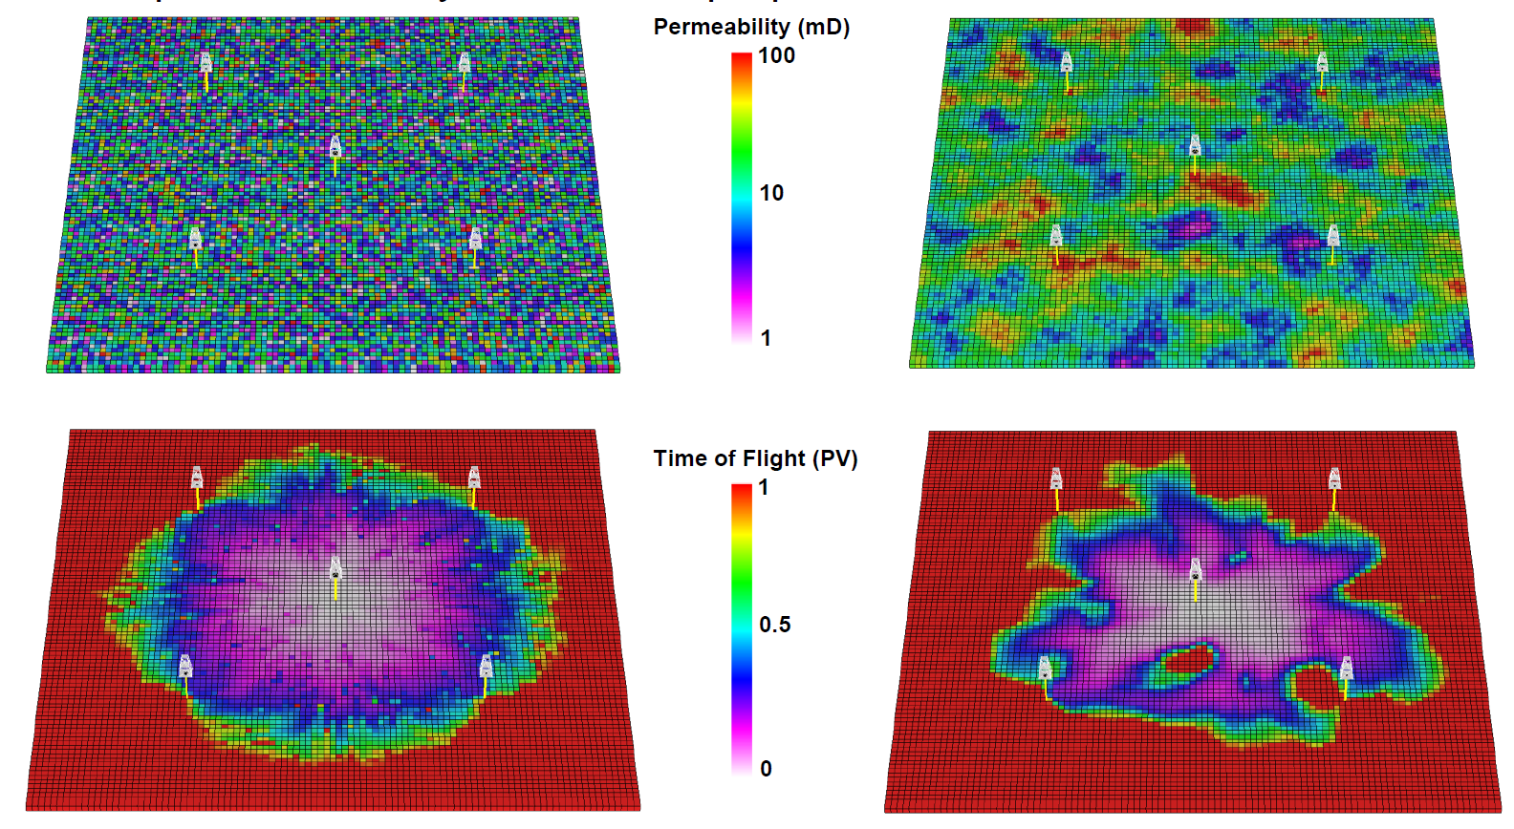
Motivation for Measuring Spatial Continuity
Does spatial continuity of reservoir properties matter?

Slide 24
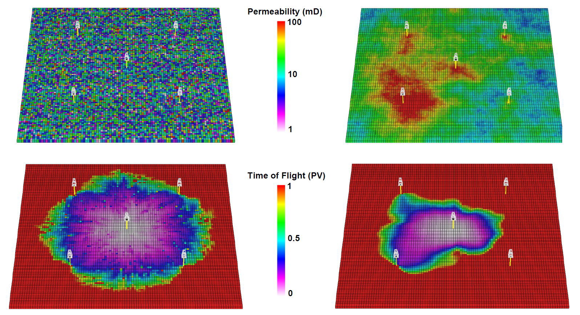
Motivation for Measuring Spatial Continuity
Does spatial continuity of reservoir properties matter?

Slide 25
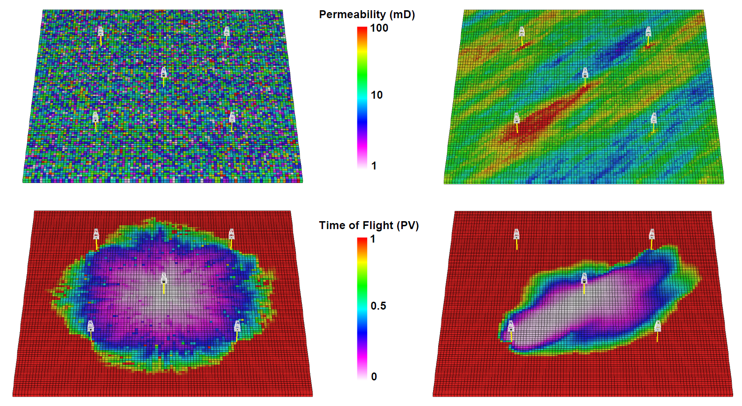
Motivation for Measuring Spatial Continuity
Does spatial continuity of reservoir properties matter?

Slide 26
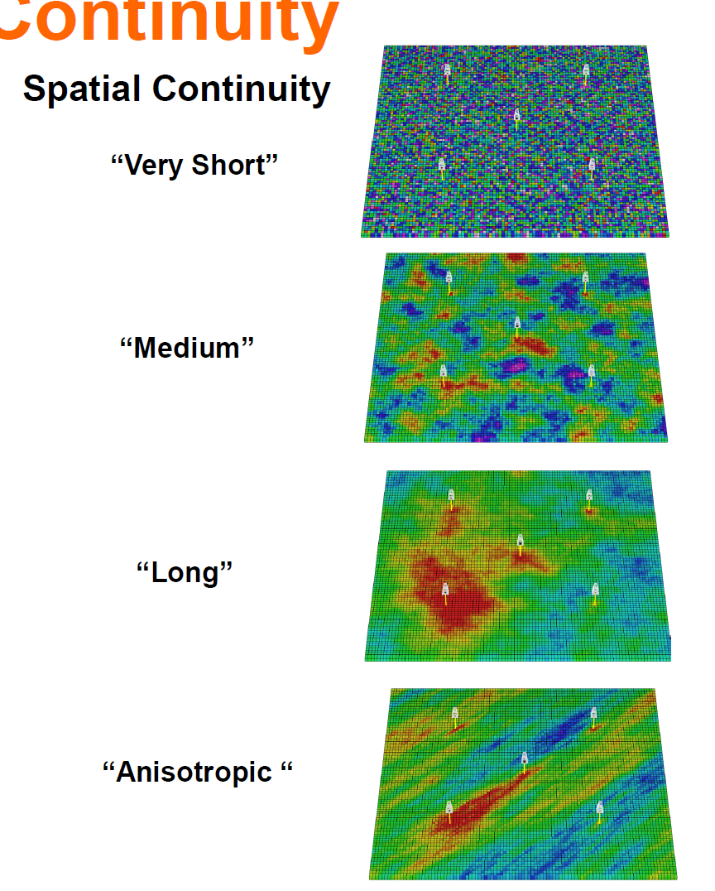
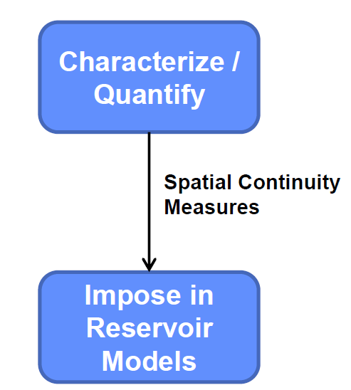
Motivation for Measuring Spatial Continuity
Spatial continuity often impacts reservoir forecasts
Need to be able to:

Slide 27
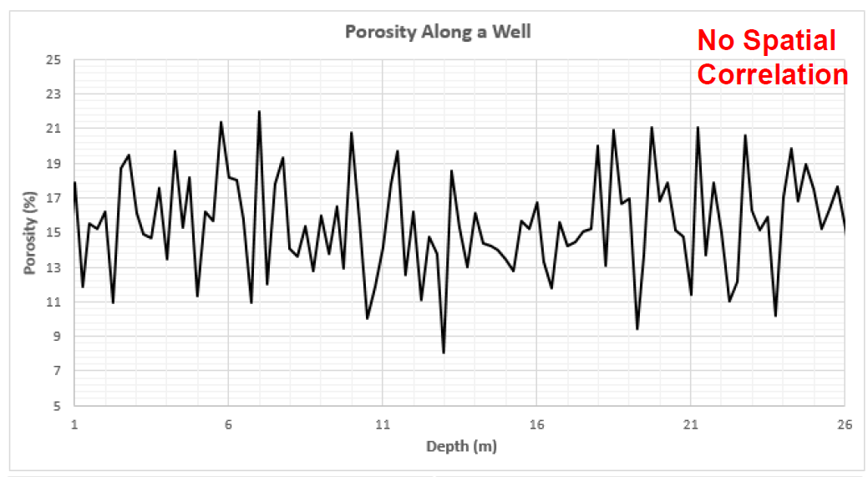
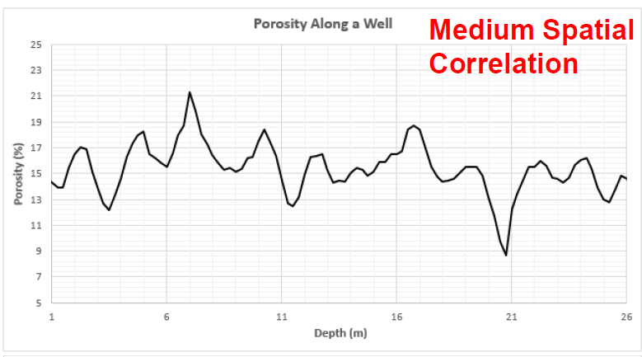
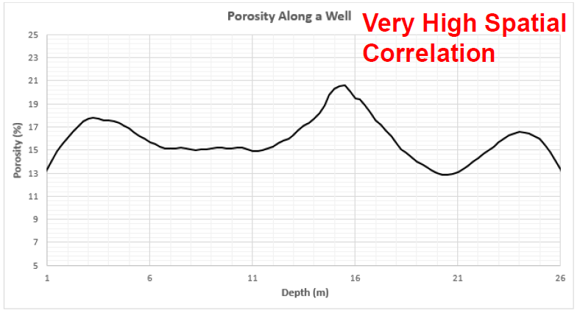
Measuring Spatial Continuity
Spatial Continuity – correlation between values over distance.
No spatial continuity: no correlation between values over distance, so random values at each location in space regardless of separation distance
Homogeneous phenomenon have perfect spatial continuity, since all values as the same (i.e., they are 100% correlated)

Slide 28
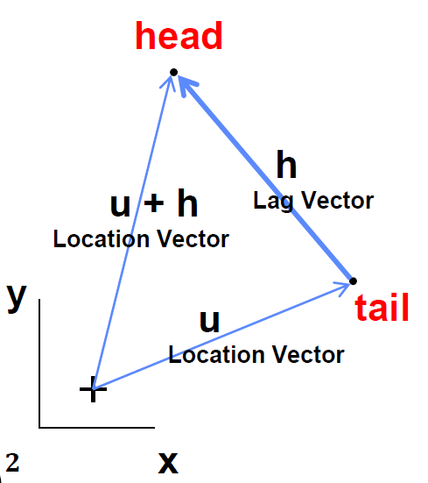
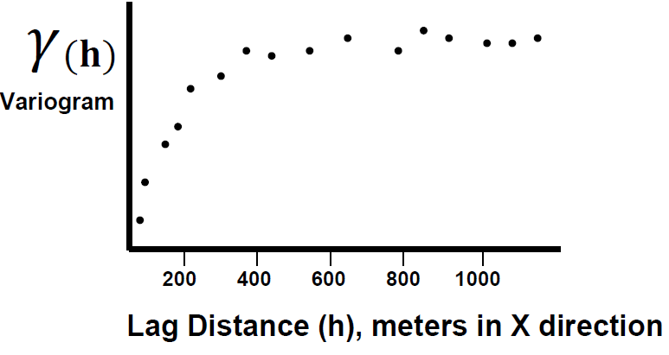
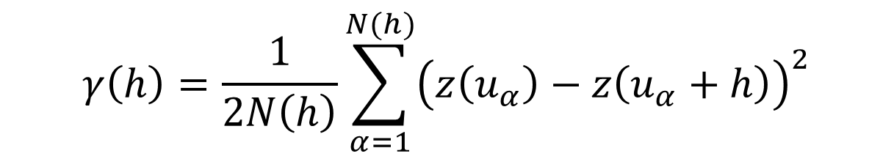
Measuring Spatial Continuity
(Semi-)Variogram – Function of difference over distance
The equation:
$$γ\left(h\right)=\frac{1}{2N\left(h\right)}\sum_{α=1}^{N(h)}{{\left(z\left(u_{α}\right)−z\left(u_{α}+h\right)\right)}^{2}}$$
Tail
Head

Slide 29
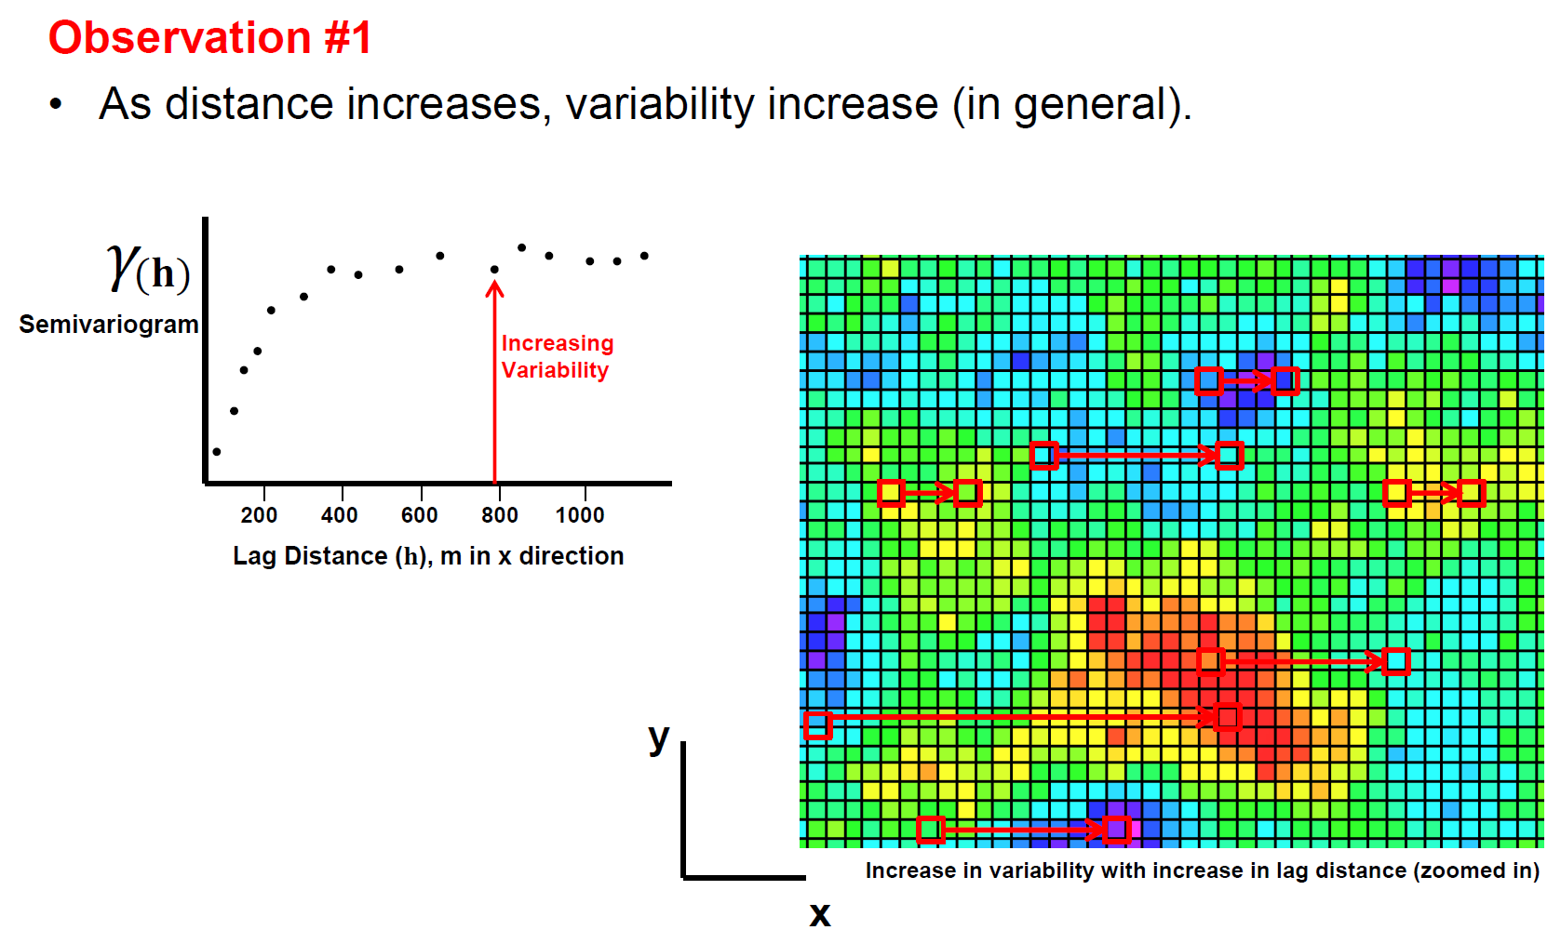
Variogram Interpretation

Slide 30
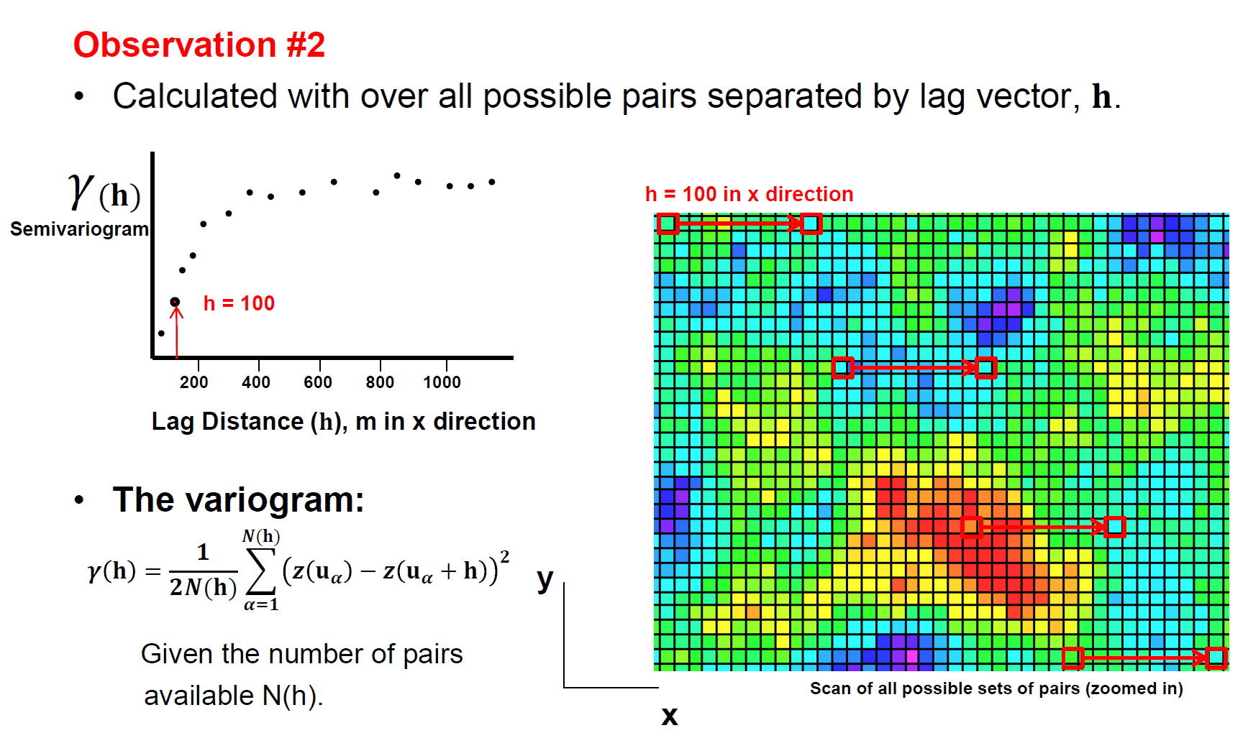
Variogram Interpretation

Slide 31
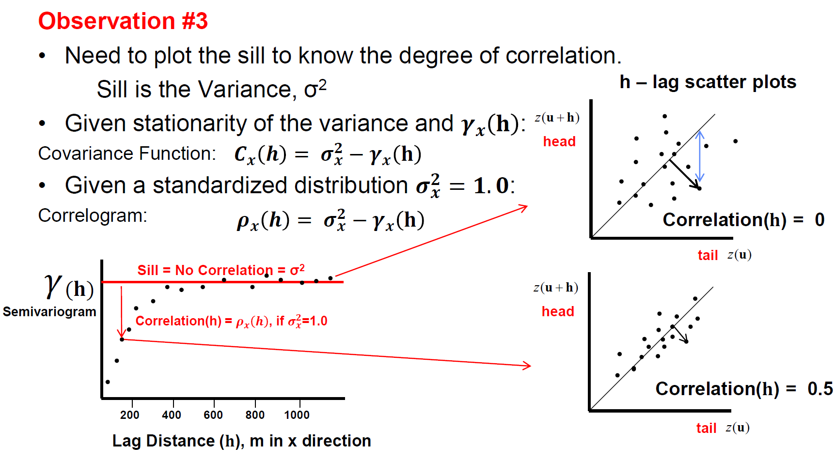
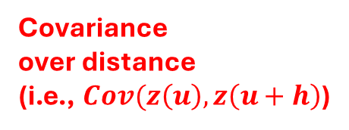
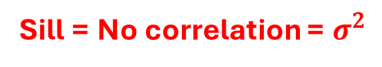
Variogram Interpretation
Sill = No correlation = $σ^{2}$
Covariance over distance
(i.e., $Cov(z\left(u\right),z\left(u+h\right)$)

Slide 32
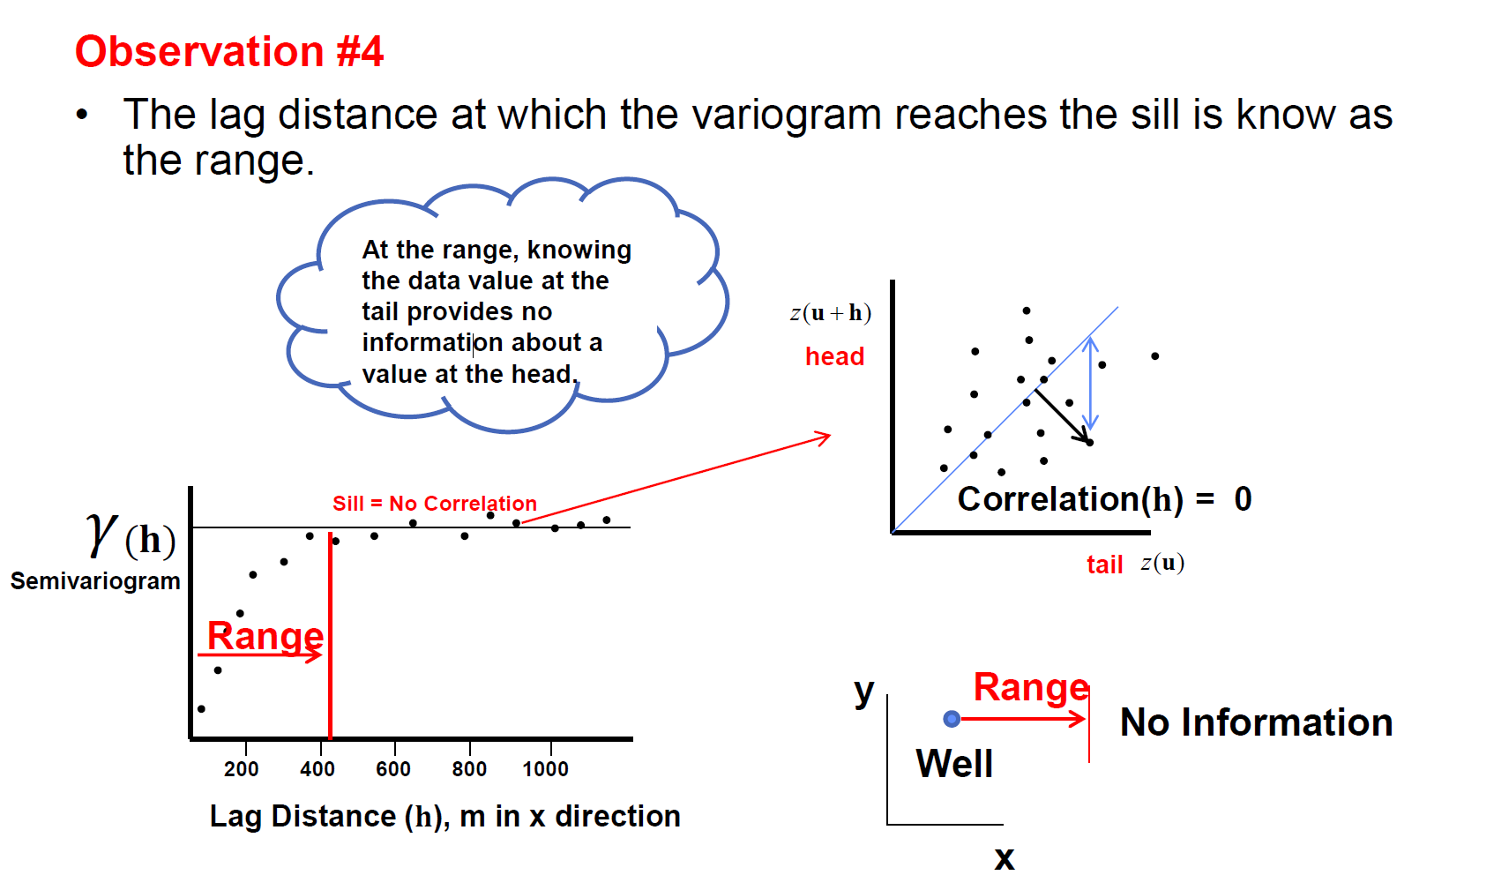
Variogram Interpretation

Slide 33
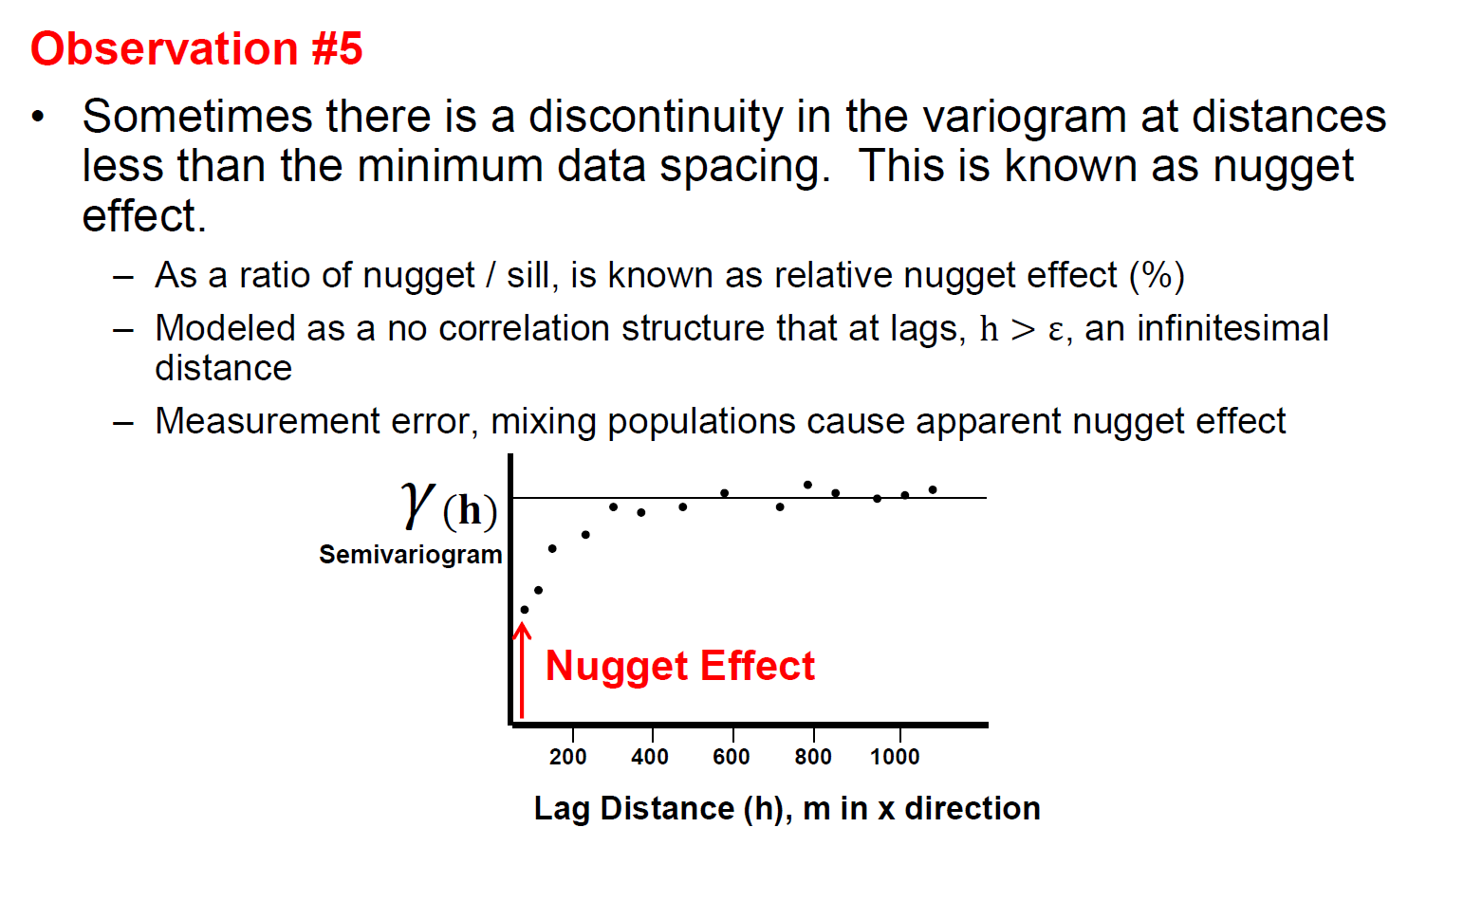
Variogram Interpretation

Slide 34
Agenda
Random variable vs. Random function
Stationarity vs. Trend
Spatial continuity: Variogram
Spatial estimation: Kriging & Simulation
GSLIB demo using Python
2D and 3D Modelling with SGS/SIS/MPS

Slide 35
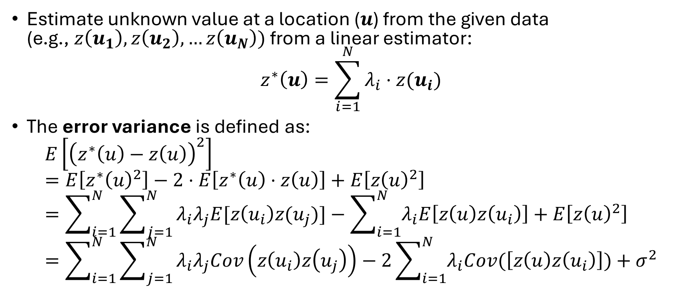
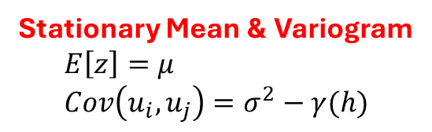
Kriging
Estimate unknown value at a location ($u$) from the given data (e.g., $z\left(u_{1}\right),z\left(u_{2}\right),…z\left(u_{N}\right))$ from a linear estimator:
$$z^{∗}\left(u\right)=\sum_{i=1}^{N}{λ_{i}⋅z(u_{i})}$$
The error variance is defined as:
$$E\left[{\left(z^{∗}\left(u\right)−z\left(u\right)\right)}^{2}\right] \\ =E\left[z^{∗}{\left(u\right)}^{2}\right]−2⋅E\left[z^{∗}\left(u\right)⋅z\left(u\right)\right]+E\left[z{\left(u\right)}^{2}\right] \\ =\sum_{i=1}^{N}{\sum_{j=1}^{N}{λ_{i}λ_{j}E[z\left(u_{i}\right)z(u_{j})]}}−\sum_{i=1}^{N}{λ_{i}E\left[z\left(u\right)z\left(u_{i}\right)\right]}+E\left[z{\left(u\right)}^{2}\right] \\ =\sum_{i=1}^{N}{\sum_{j=1}^{N}{λ_{i}λ_{j}Cov\left(z\left(u_{i}\right)z\left(u_{j}\right)\right)}}−2\sum_{i=1}^{N}{λ_{i}Cov(\left[z\left(u\right)z\left(u_{i}\right)\right]})+σ^{2}$$
Stationary Mean & Variogram $$E\left[z\right]=μ \\ Cov\left(u_{i},u_{j}\right)=σ^{2}−γ(h)$$

Slide 36
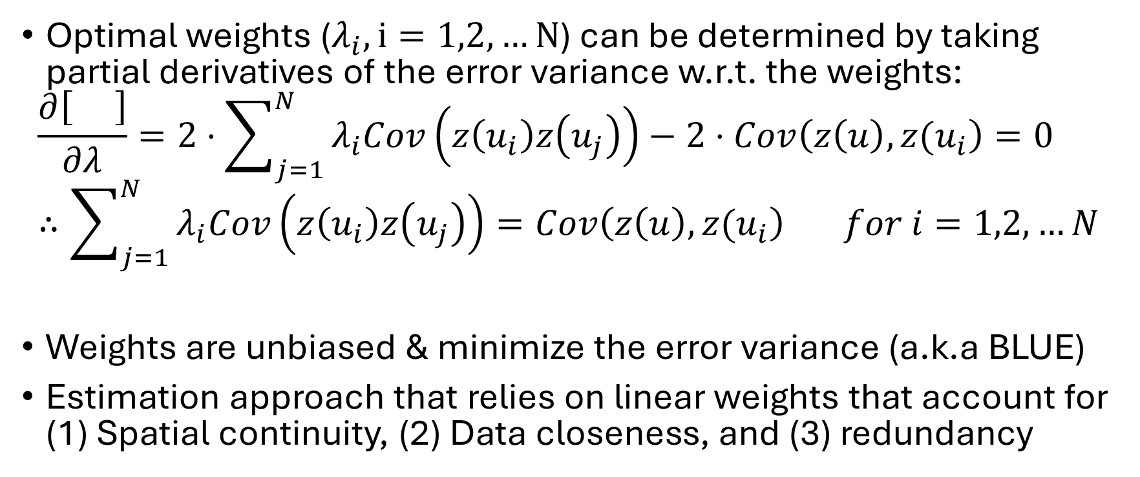
Kriging
Optimal weights ($λ_{i}, i=1,2,…N$) can be determined by taking partial derivatives of the error variance w.r.t. the weights:
$$\frac{∂\left[ \right]}{∂λ}=2⋅\sum_{j=1}^{N}{λ_{i}Cov\left(z\left(u_{i}\right)z\left(u_{j}\right)\right)}−2⋅Cov\left(z\left(u\right),z(u_{i}\right)=0 \\ ∴\sum_{j=1}^{N}{λ_{i}Cov\left(z\left(u_{i}\right)z\left(u_{j}\right)\right)}=Cov\left(z\left(u\right),z(u_{i}\right) for i=1,2,…N$$
Weights are unbiased & minimize the error variance (a.k.a BLUE)
Estimation approach that relies on linear weights that account for (1) Spatial continuity, (2) Data closeness, and (3) redundancy

Slide 37
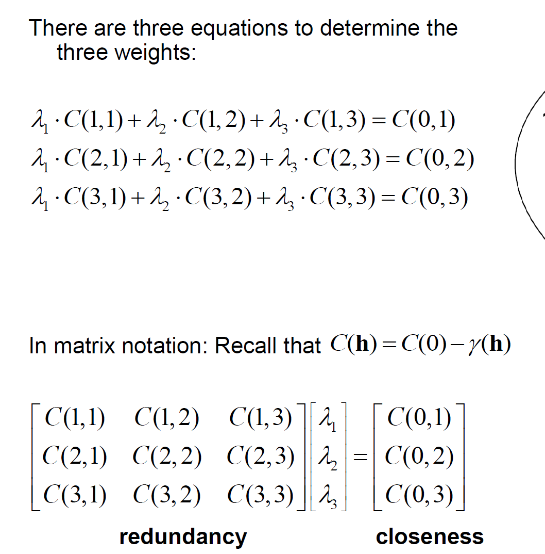

Simple Kriging
Redundancy
Closeness
Spatial continuity

Slide 38

Simple Kriging’s properties
Solution exists and is unique of positive definite matrix
Provides a measure of the estimation (or kiring) variance (uncertainty in the estimate):
$$σ_{E}^{2}\left(u\right)=σ^{2}−\sum_{i=1}^{N}{λ_{i}⋅Cov\left(u−u_{i}\right)}$$ $$σ_{E}^{2}\left(u\right)→\left[0,σ^{2}\right]$$

Slide 39

Ordinary Kriging
Note that Ordinary Kriging does not requires the mean to be known. It estimates to mean locally

Slide 40

Limitation in Kriging
Kriging is an estimation method. The goal of estimation is the most likely values at each location, resulting in “Too Smooth!”
Not honoring the distribution & variogram model

Slide 41
Estimation vs. Simulation
Estimation:
honors local data
locally accurate
smooth
overestimate spatial continuity →underestimate RF
no assessment of global distribution
Simulation:
honors local data
reproduce histogram
honors spatial variability
Alternative realizations available
Assessment of global uncertainty is possible

Slide 42
Sequential Gaussian Simulation
Establish grid network and coordinate system, flatten system
Transform data to “normal space”
Assign data to the nearest grid node
Calculate variogram
Determine a random path through all of the grid nodes
» find nearby data and previously simulated grid nodes
» construct the conditional distribution by kriging
» draw simulated value from conditional distribution
» assign the simulated value to the grid as data
Check results E.g., honor data/histogram/variogram
Back transform from “normal space”
Restore to original framework
Check honor concept of geology
Loop over model nodes
Loop over realizations

Slide 43
Sequential Gaussian Simulation
Sequential – sequential inclusion of simulated values to impose the correct spatial correlation between the simulated values
Gaussian – work in Gaussian space since the local conditional distribution shape is parameterized by mean (kriging estimate) and variance (estimation variance)
Simulation – simulation through Monte-Carlo simulation from the local distribution of uncertainty and construction of multiple equiprobable realization

Slide 44
Agenda
Random variable vs. Random function
Stationarity vs. Trend
Spatial continuity: Variogram
Spatial estimation: Kriging & Simulation
GSLIB demo using Python
2D and 3D Modelling with SGS/SIS/MPS

Slide 45


References

Slide 46
Thank you ☺

